Slide 1

Rockbuster Stealth LLC
Launch Strategy
Tableau link: 3.10 Tableau Presentation | Tableau Public

Slide 2

Table of Contents
Project Overview
Key Questions
Summary Statistics
Key Data
Insights and Recommendations

Slide 3

Key Questions
Which movies contributed the most/least to revenue gain?
What was the average rental duration for all videos?
Which countries are Rockbuster customers based in?
Where are customers with a high lifetime value based?
Do sales figures vary between geographic regions?

Slide 4

Summary Statistics
Lowest Rental Rate:
$0.99
Shortest Rental Duration:
3 Days
Minimum Replacement Cost:
$9.99
Average Rental Rate:
$2.98
Highest Rental Rate:
$4.99
Longest Rental Duration:
7 Days
Maximum Replacement Cost:
$29.99
Average Rental Duration:
4.985 Days

Slide 5

Key Data

Slide 6
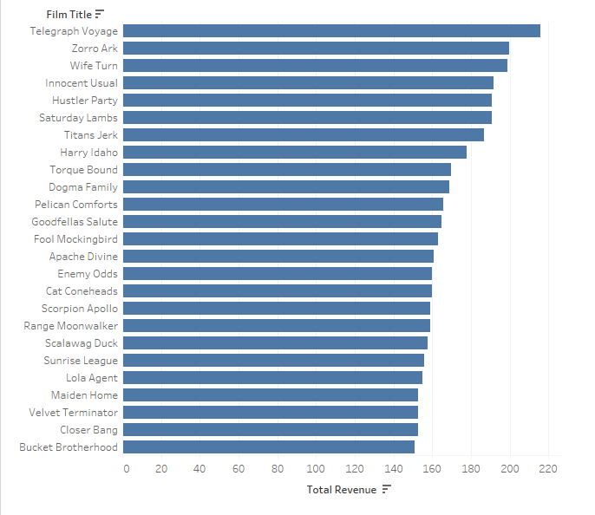
Which movies contributed most to revenue gain? Rockbuster’s Top 25 Films

Slide 7
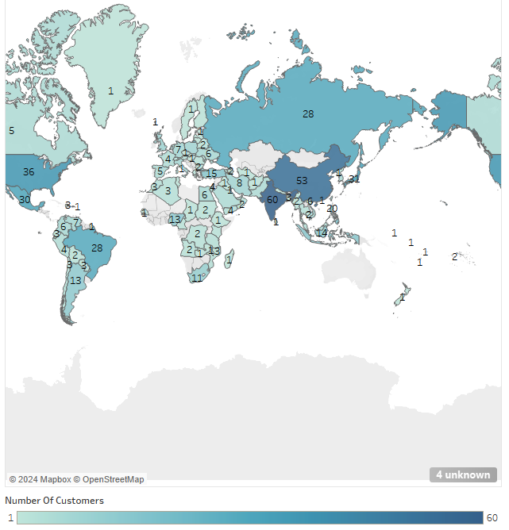
Which Countries have the Most Rockbuster Customers?

Slide 8
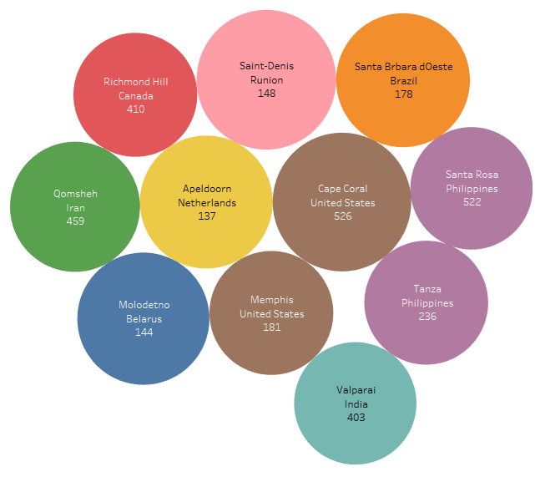
Where are customers with a high lifetime value? Highest Value Customers by Number (for privacy), City, and Country

Slide 9
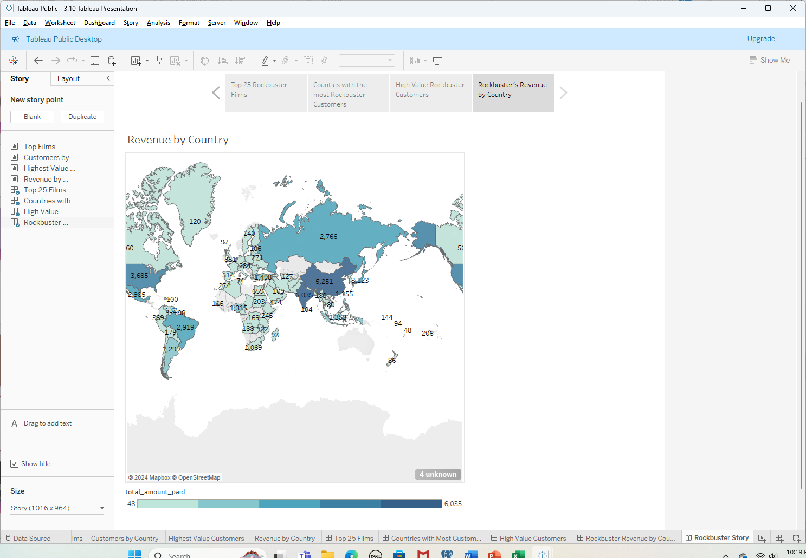
Do sales figures vary between geographic regions? Revenue by Country

Slide 10
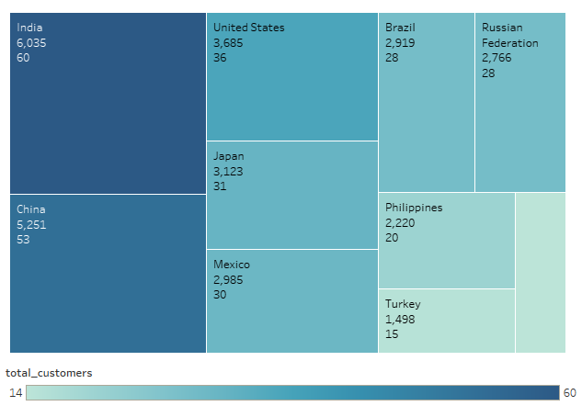
Do sales figures vary between geographic regions? Countries generating the most revenue

Slide 11

Insights and Recommendatons

Slide 12
Insights Recommendations
Moving toward an online platform will significantly reduce overheard costs, such as storefronts, employees, and replacement costs. Services like Netflix already show that customers want to stream movies.
China and India are the largest markets, so expand offerings in those languages. Also, expand libraries of titles in Spanish and Russian.
While the 3 genres listed earlier are the most popular, that may not be true once we offer titles in other languages. Rockbuster should conduct more market research to see what movies are most popular in other countries.
Rockbuster should implement a customer loyalty program to keep high value customers and promotions and incentives to bring in new customers.
The data shows that Rockbuster has a varied market across many countries. The largest markets are in the Americas and Asia, India and China being the largest.
It also shows that sports, science fiction, and animation are the most popular genres.
The average rental duration date is about 5 days, and the average rental rate is $2.98

